Slide 1
Video Game Sales
Jade Nguyen
CIS Final Project Proposal

Slide 2
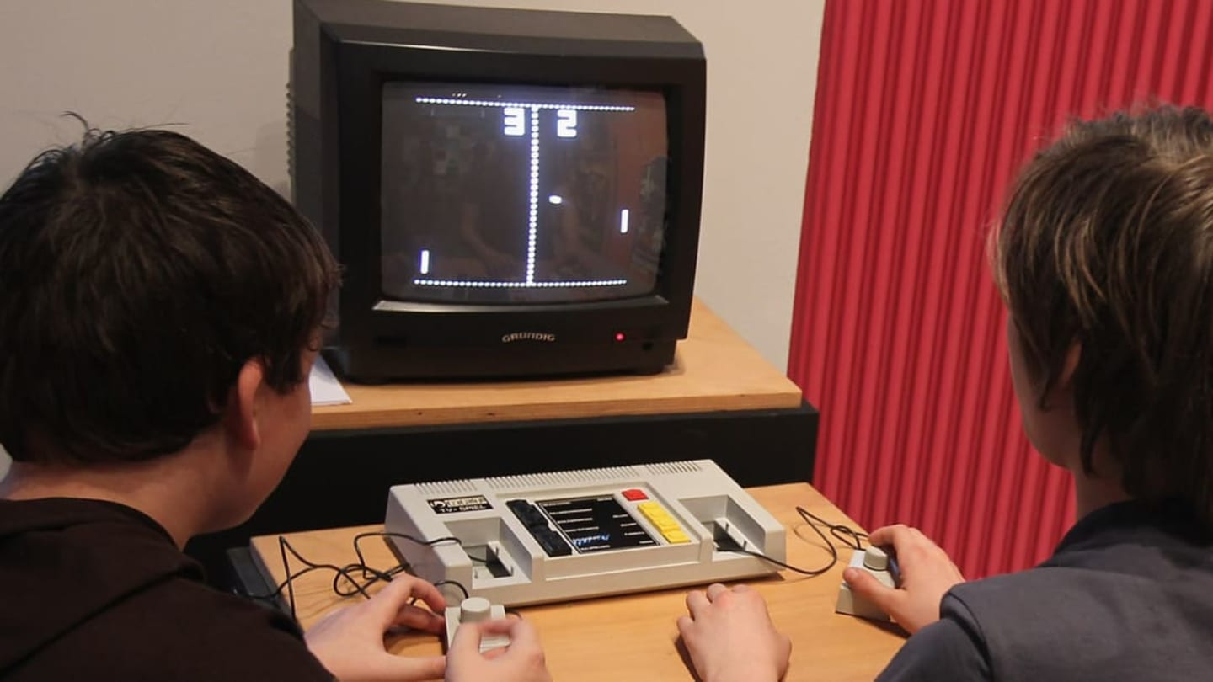

Why video games?
They've introduced innovative storytelling techniques, promoted teamwork and problem-solving through multiplayer modes, and even spurred the growth of competitive esports.
Notes:
Video games have influenced culture and society in numerous ways

Slide 3
To start ...
"What correlations or patterns exist between variables such as genre, platform, release year, global sales, and ratings concerning sales performance, and how can these insights inform future game development and marketing strategies?"
"What are the most common behaviors or patterns observed in the dataset, and how do they vary across platforms?"

Slide 4
Dataset 1
Dataset 1 | https://www.kaggle.com/datasets/gregorut/videogamesales
Rank | Ranking of overall sales
Name | The name of the game
Platform | Platform of the game release (PC, PS4, Wii, Xbox, etc.)
Year | Year of the game release
Genre | Genre of the game
Publisher | Name of the publisher of the game
NA_Sales | Sales in North America (in millions)
EU_Sales | Sales in Europe (in millions)
JP_Sales | Sales in Japan (in millions)
Other_Sales | Sales in the rest of the world (in millions)
Global_Sales | Total worldwide sales (in millions)

Slide 5
Dataset 2
Dataset 2 | https://www.kaggle.com/datasets/ashaheedq/video-games-sales-2019
Rank | Ranking of overall sales
Name | Name of the game
Genre | Genre of the game
ESRB Rating | ‘Entertainment Software Ratings Board’ Rating
Platform | Platform of the game (PC, PS4, Xbox, etc.)
Publisher | Publisher of the game
Developer | Developer of the game
VGChartz Score | Video Game Chartz.com score https://www.vgchartz.com/gamedb/
Critic Score | Critic score of the game 1-10
User Score | Users’ score of the game 1-10
Total Shipped | Total shipped copies of the game
Global Sales | Total worldwide sales (in millions)
NA Sales | Sales in North America (in millions)
PAL Sales | Sales in Europe (in millions)
JP Sales | Sales in Japan (in millions)
Other Sales | Sales in the rest of the world (in millions)
Year | Year of the game release
Last Update | Last day of updates on the game

Slide 6
To be continued ...
Cross-reference the data and find correlations and accuracy between both datasets.
Continue research to find more insight into why the games were so popular in the year they were released.
Create visualizations to show trends in the demographics, year, and sales performance.
Notes:
Cross-reference the data and find correlations and accuracy between both datasets and the data provided in the dataset to see which dataset will give better results.
Continue research to find more insight into why the games were so popular in the year they were released and see if it had to do anything with platform releases or what the gaming environment was like at the time.

Slide 7
Outcome Goals using y = sales or y = rank
Market Analysis
Ranking
System Recommendation
Notes:
Market analysis: If your objective is to analyze the video game market trends, the outcome could be insights into which genres, platforms, publishers, or developers are most successful in terms of sales or critical reception
Ranking: If your focus is on analyzing ranking trends, the outcome could involve visualizations showing how game rankings have changed over time and identifying any patterns or trends in the data.
System recommendation: Another potential outcome could be the development of a recommendation system that suggests games to users based on their preferences, historical sales data, or user ratings.

